Slide 1
Customer Segmentation Using Clustering

Slide 2
Identifying distinct customer groups based on Spending Score and Demographic Features.
By DSI team 2
Miguel
Sanyam
Preethi
Harris
Olena
Emilia

Slide 3
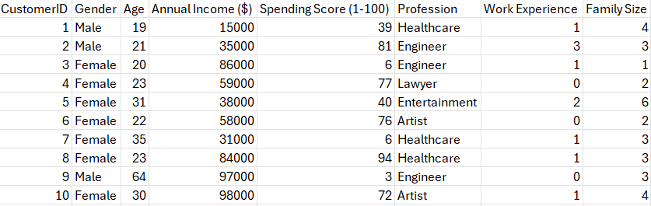
Problem Statement
Can we cluster customers into distinct segments based on their Spending Score and demographic features (Age, Gender, Profession)?

Slide 4
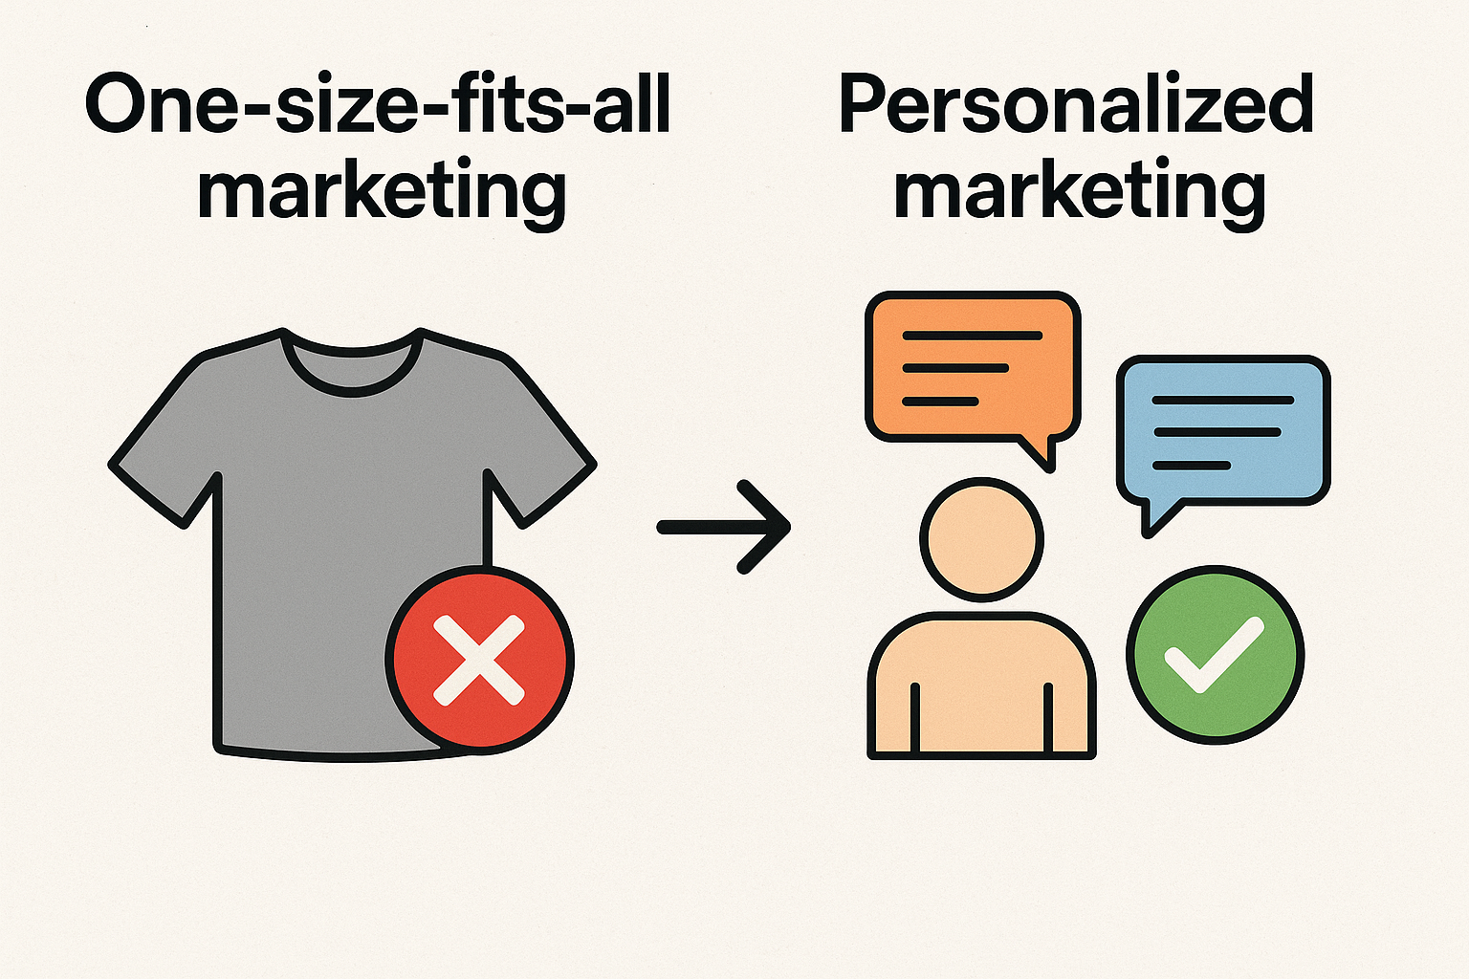
Business Context
Retail companies collect large amounts of customer data but struggle to understand diverse customer behaviors. Treating all customers the same, leads to ineffective marketing strategies.
Customer segmentation helps in identifying group of customers with similar characteristics for tailored offers and marketing campaigns, which in turn leads to higher ROI, customer loyalty, and profitability.

Slide 5
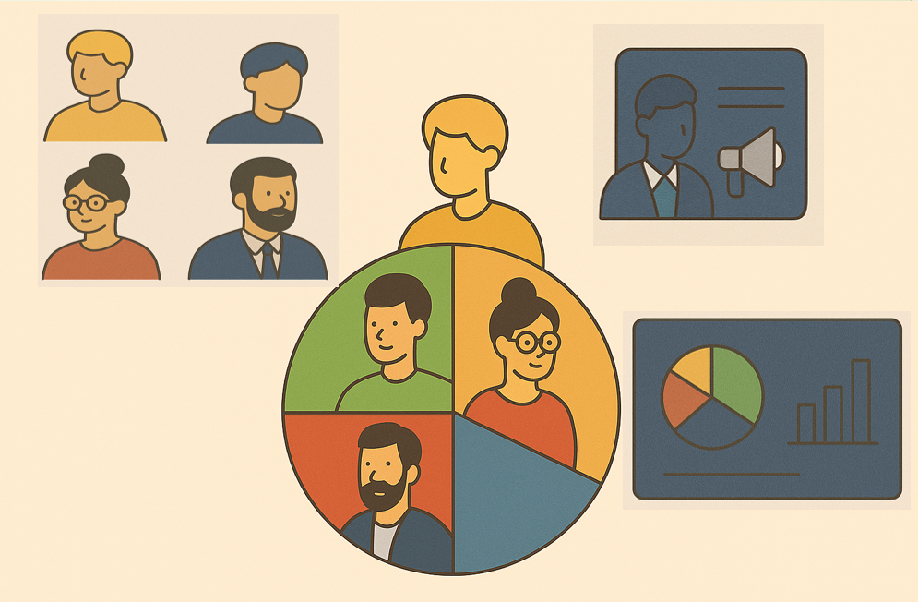
Project Objective
Group customers using data analysis techniques based on demographics and spending.
Understand the characteristics of each segment/cluster (age range, profession, spending pattern, etc.).
Identify customer types: high-value, budget-conscious, and mid-range.
Use insights to help the business in decision-making and design personalized marketing campaigns for each segments.

Slide 6
Technical Stack
Python, version 3.9+
Jupyter Notebook
Libraries used in Python:
Numpy: matrix operations
2. Pandas: data analysis
3. Matplotlib: creating graphs and plots
4. Seaborn: enhancing matplotlib plots
5. SKLearn: regression analysis

Slide 7
Dataset Overview
Source: Kaggle — Shop Customer Dataset
Size: ~2000 customers
Columns/ Features considered from the dataset for the data analysis:
Age
Gender
Profession
Annual Income
Spending Score (1–100)

Slide 8
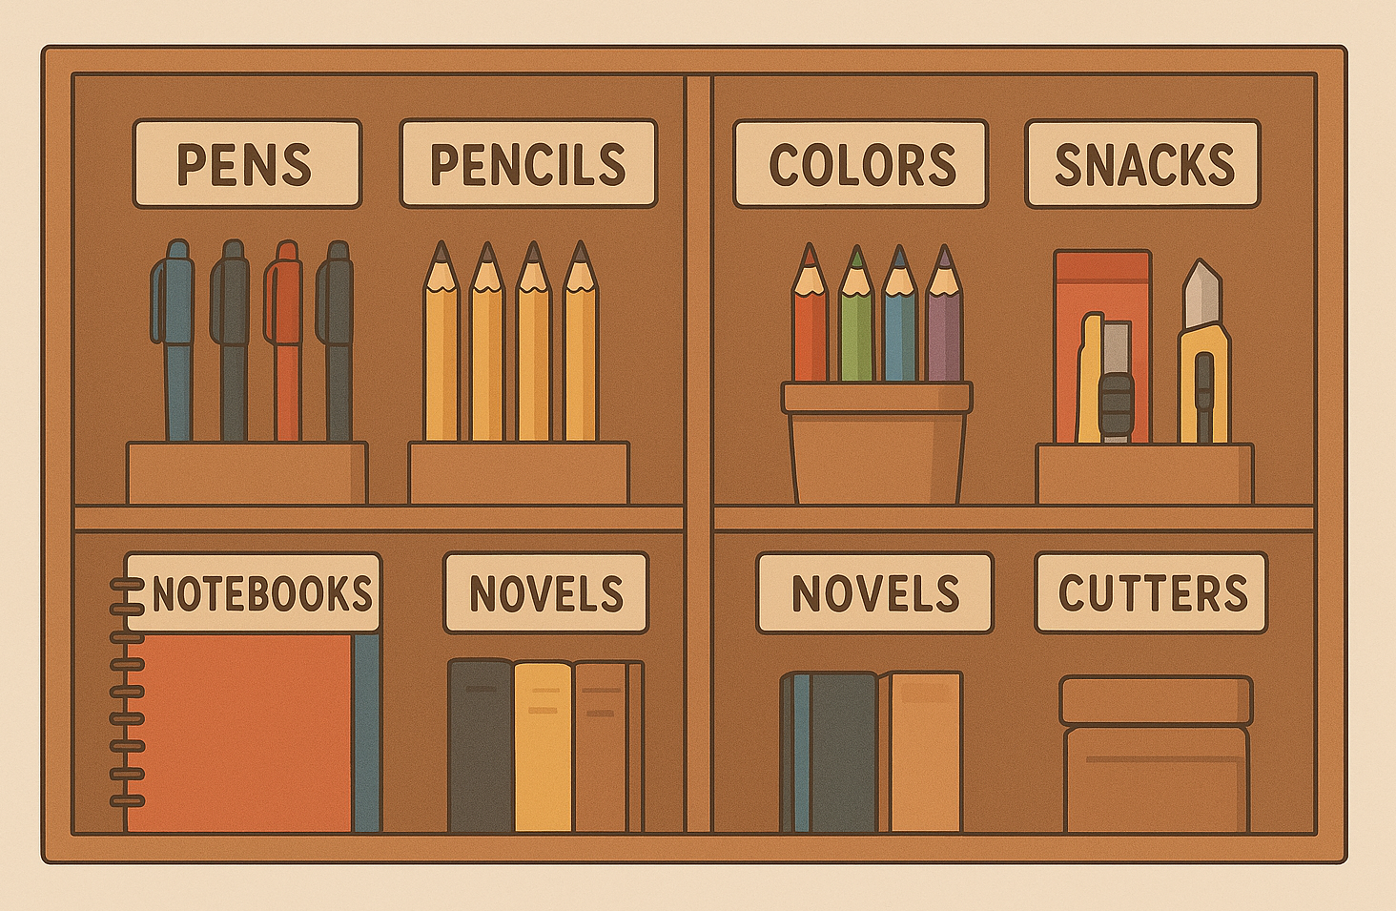
What is Clustering?
Clustering is a data analysis technique that groups similar data points together.
It helps find patterns or natural groupings within large datasets.
Each group (called a cluster) contains data points that are more similar to each other than to those in other groups.
It’s an unsupervised learning method, meaning it doesn’t rely on predefined labels or outcomes.
In customer segmentation, clustering helps identify different types of customers based on behaviors and characteristics.
A Student bookshelf clustered based on the category of each product.

Slide 9
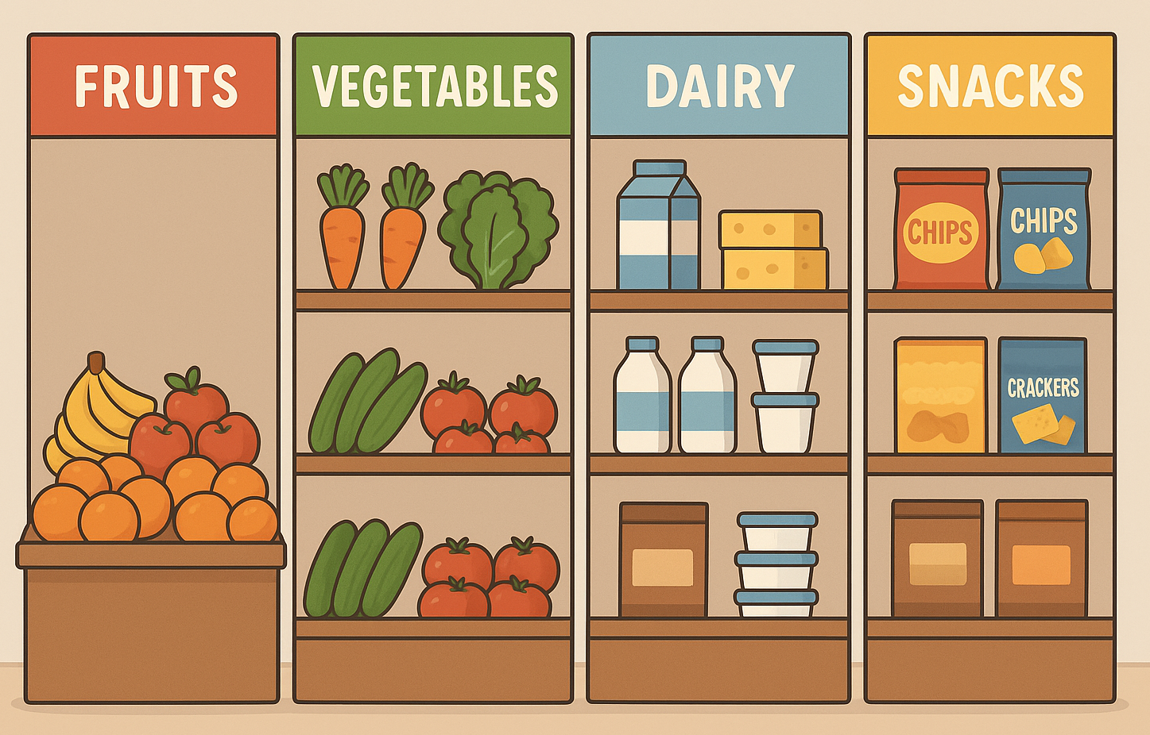
Why Clustering?
Helps businesses understand hidden patterns in customer data.
Enables personalized marketing strategies for each group.
Improves decision-making by identifying key customer segments (e.g., high spenders vs. budget buyers).
A Grocery store clustered based on the category of each product.
We are using this Clustering Technique to group customers into one of the three clusters/ segments designed.

Slide 10
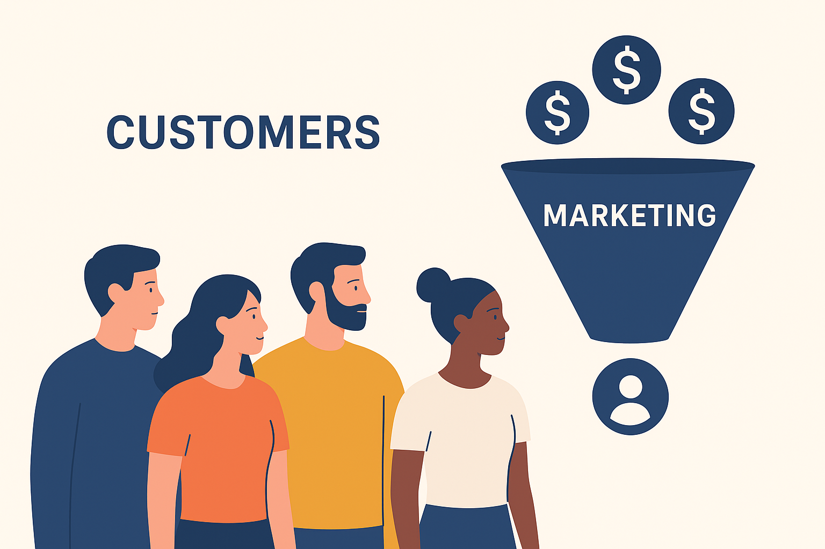
Business Value
Implementing customer segmentation provides multiple strategic benefits:
Targeted Marketing: Tailored marketing campaigns to specific customer preferences.
Improved Customer Retention: Personalizing experiences and offers fosters stronger customer relationships and long-term loyalty.
Efficient Resource Allocation: Focused marketing and operational resources on high-value segments helps in improving ROI and operational efficiency.

Slide 11
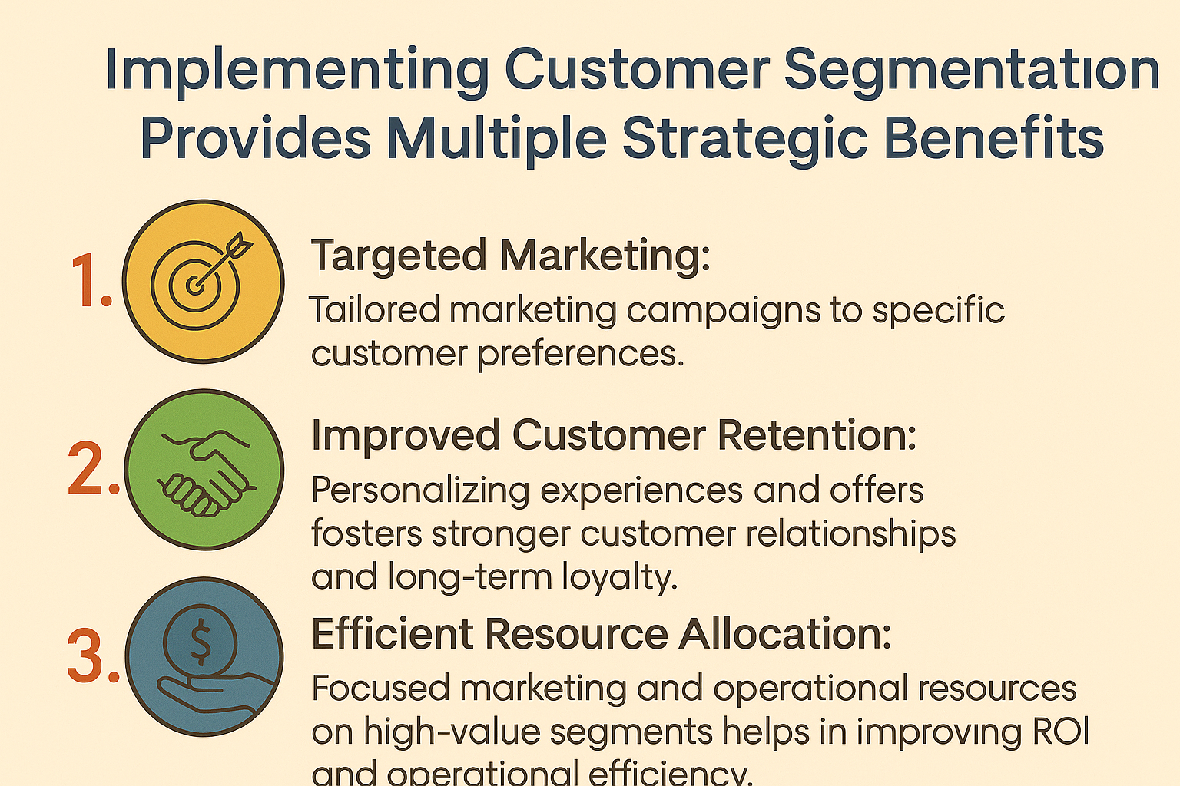
Expected Outcome
Identification of high-value customer segments that contribute significantly to revenue based on demographic and behavioral characteristics (e.g., income, spending habits, age groups).
Recognition of potential customer segments for targeted marketing campaigns.
Understanding of customer preferences and behaviors to improve product offerings, thereby improving customer engagement.

Slide 12
Key takeaways

Slide 13
Impacts

Slide 14
Future Enhancements

Slide 15
Thank you

